Slide 1

Annual Differentiated Education Plan Meeting
South Academy of International Languages
Fall 2021

Slide 2
Meet Ms. Lynch
20+ years with the Smith/Waddell/SAIL middle school Language Immersion program
Academic Facilitator with the program 10+ years
Provide PD for teachers and staff
Master scheduler
Coordinate MS exchange to Germany
Math 2 Teacher

Slide 3

Our Meeting Goals:
Explore how the academic, social, and emotional needs of gifted and advanced students are met through the school’s gifted services.
Learn more about the middle school gifted services at SAIL
Review the Differentiated Education Plans and Performance Reviews for grades 6-8.

Slide 4
Article 9B
§ 115C-150.5. Academically or intellectually gifted students. The General Assembly believes the public schools should challenge all students to aim for academic excellence and that academically or intellectually gifted students perform or show the potential to perform at substantially high levels of accomplishment when compared with others of their age, experience, or environment. Academically or intellectually gifted students exhibit high performance capability in intellectual areas, specific academic fields, or in both intellectual areas and specific academic fields. Academically or intellectually gifted students require differentiated educational services beyond those ordinarily provided by the regular educational program. Outstanding abilities are present in students from all cultural groups, across all economic strata, and in all areas of human endeavor. (1996, 2nd Ex. Sess., c. 18, s. 18.24(f).)

Slide 5
Academic Facilitator as AIG Contact
Provides professional development for staff on instructional best practices
Models best practices for gifted learners
Creates and provides resources to support teachers in meeting advanced learning needs of gifted students
Participates in grade level PLCs for collaborative planning using differentiated instruction

Slide 6

Our MS TD Program
Focus on quality not quantity
  Quality of thinking, not more of the same
High expectations all day, every day
Complex, challenging & real world
Collaborative, integrated, and inclusive

Slide 7
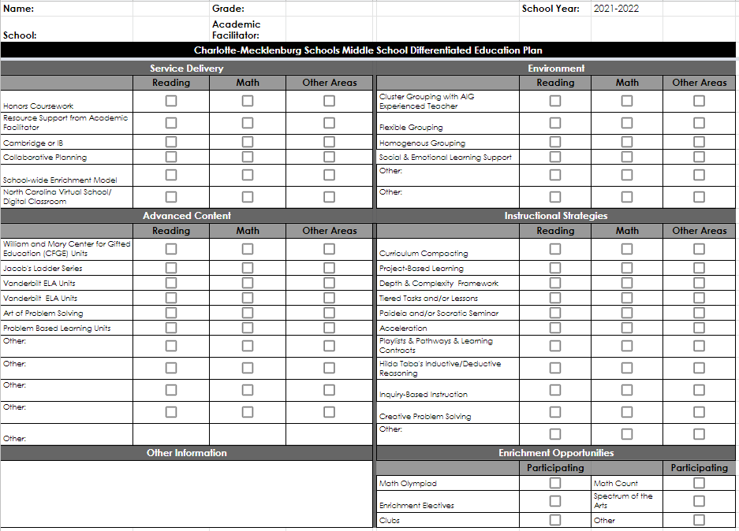
Differentiated Education Plan
Based on students’ demonstrated needs, teachers and I determine the following DEP elements:
Service Delivery
Advanced Content
Learning Environment
Instructional Models, Models, and Strategies
Enrichment Opportunities

Slide 8
Service Delivery

Slide 9
Delivery
Differentiation Model based on DLI/Heritage World Language Immersion
Pre-assessments and other formative assessments to determine appropriate differentiation opportunities
Honors-level pathways in English and Math
Departmentalizing allows students to receive acceleration and enrichment within their strength(s)
Resource support from Academic Facilitator
Academic Enrichment and Elective choice allows students to explore interest areas and hone their creativity while still meeting their needs

Slide 10
Advanced Content

Slide 11
Content
Differentiated Instruction
  Interest/Choice Projects
  Tailored small group instruction
  Project/Problem based learning
Greater depth of exploration
Subject integration through conceptual units
Standard curriculum extensively supplemented with research-based gifted resources & strategies
  William & Mary Language Arts and Science Units
  Art of Problem Solving
  Vanderbilt ELA Units
  PBL unit explorations

Slide 12







Literacy & Social Studies
Advanced Curriculum from Vanderbilt University’s Program for Talented Youth
Why?
Van Tassel-Baska’s Integrated Curriculum Model and 5 - 7 advanced are integrated using high-level texts for gifted students
How?
Academic Facilitators can model, coach, or provide models or infuse the content or model to align with the EL Curriculum.

Slide 13
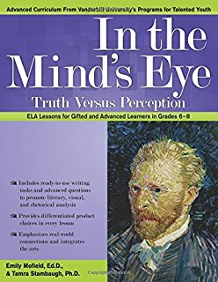
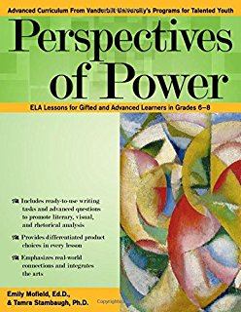
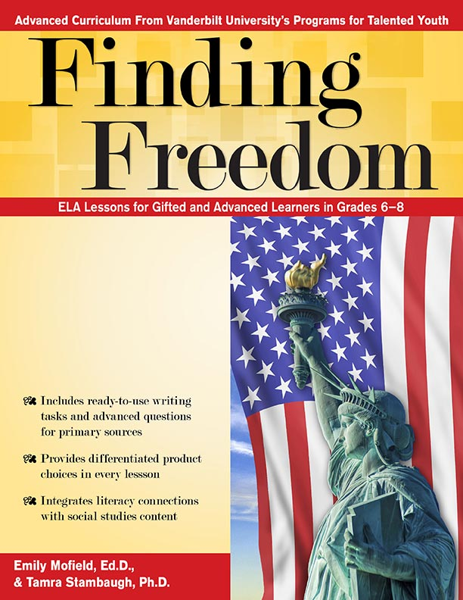
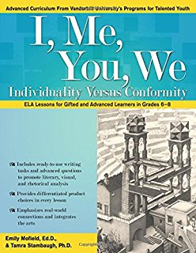
Literacy & Social Studies
Advanced Curriculum from Vanderbilt University’s Program for Talented Youth
Why?
Integrating advanced content and concept using literary, non-fiction, visual, and Social Studies wheels for deeper analysis in rhetoric, genres, structure, and author’s intent.
How?
The units are infused to supplement or replace elements of EL Curriculum for gifted students.

Slide 14





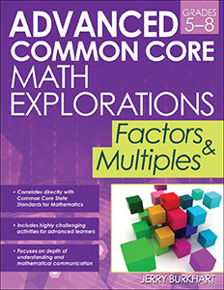
Mathematics
The Art of Problem Solving Series & other resources
Why?
The questions offer contours of opportunities that go broader, deeper, and complex into real-world connections and problems.
How?
The resources can be infused during core curriculum or as enrichment opportunities for mathematically gifted students.

Slide 15
Mathematics
6th grade - Honors level
7th grade - Honors and NC Math 1
8th grade - NC Math 1 and NC Math 2

Slide 16
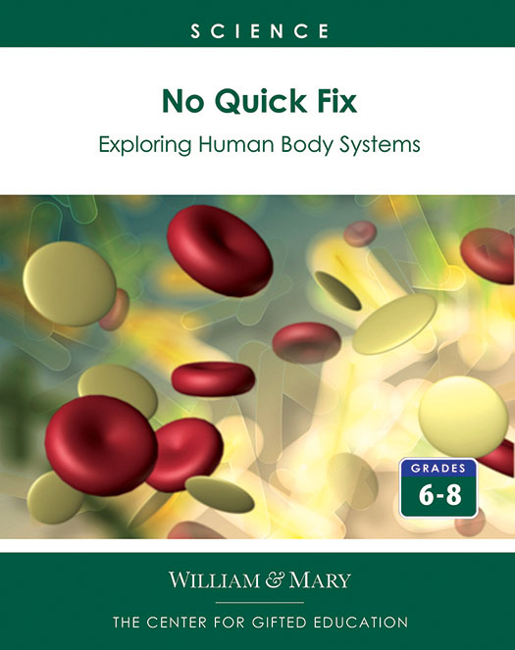
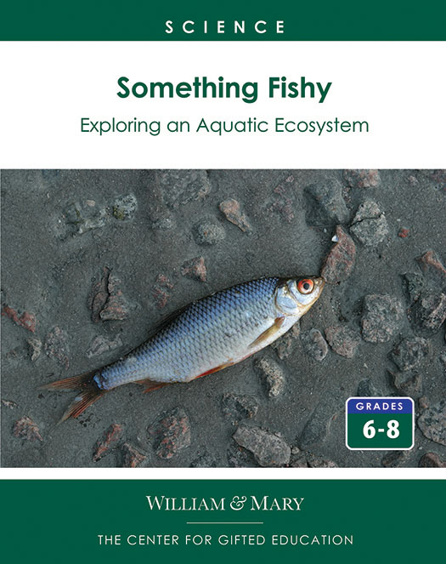


Science
Problem-based Learning (PBL)
Why?
An inquiry-based model of curriculum and instruction that initiates learning with an ill-structured problem that has been carefully constructed to guide students to a specific topic in science core standards and Next Generation Learning Standards. The ill-structured problem engages students’ natural curiosity by drawing on the power of storytelling. Intrigued by the problem, students ask questions that lead them into the study of the core content area.
How?
The resources can be infused during core curriculum or as enrichment opportunities for gifted students.

Slide 17

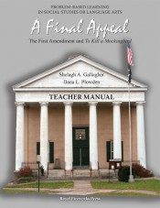
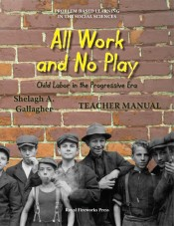
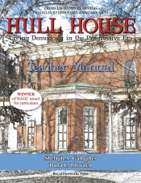

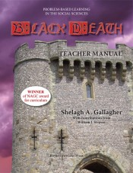
Social Studies
Dr. Gallagher’s Problem Based Learning
Why?
Units are designed using real-world problems. Students focus on inquiry-based instruction and learning. Units are highly engaging and use primary sources.
How?
The resources can be infused during core curriculum or as enrichment opportunities for gifted students.

Slide 18
Environment & Social & Emotional

Slide 19
Environment
Various grouping options including flexible, homogeneous and heterogeneous
Data driven instruction

Slide 20
Social and Emotional
Use of advisory, morning meetings, character education - all part of Caring Schools Curriculum
Small groups with counselor determined by needs assessments
Use of Panorama survey data to address SEL needs

Slide 21
Instructional Methods, Models & Strategies

Slide 22
What Types of Strategies are Used?
Problem/Project Based Learning
Paideia Seminars/Socratic Seminars
Interest/Choice Boards, Learning Menus
Inquiry-Based Learning Approaches
Thinking Maps
Flexible Grouping
Tiered Tasks and/or Lessons
Conceptual Learning Units
Creative Problem Solving
Kaplan’s Depth and Complexity
...and so much more!

Slide 23
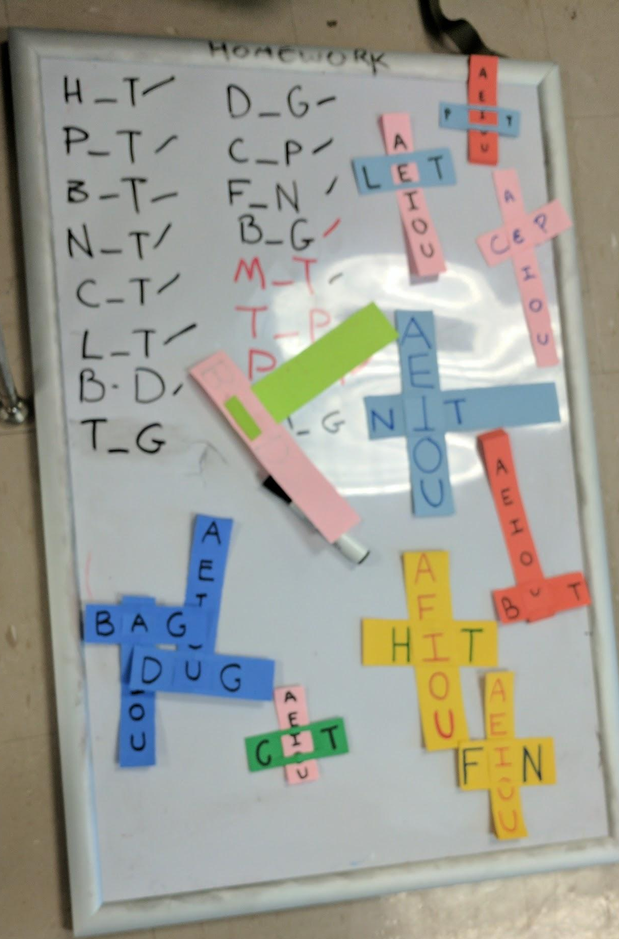
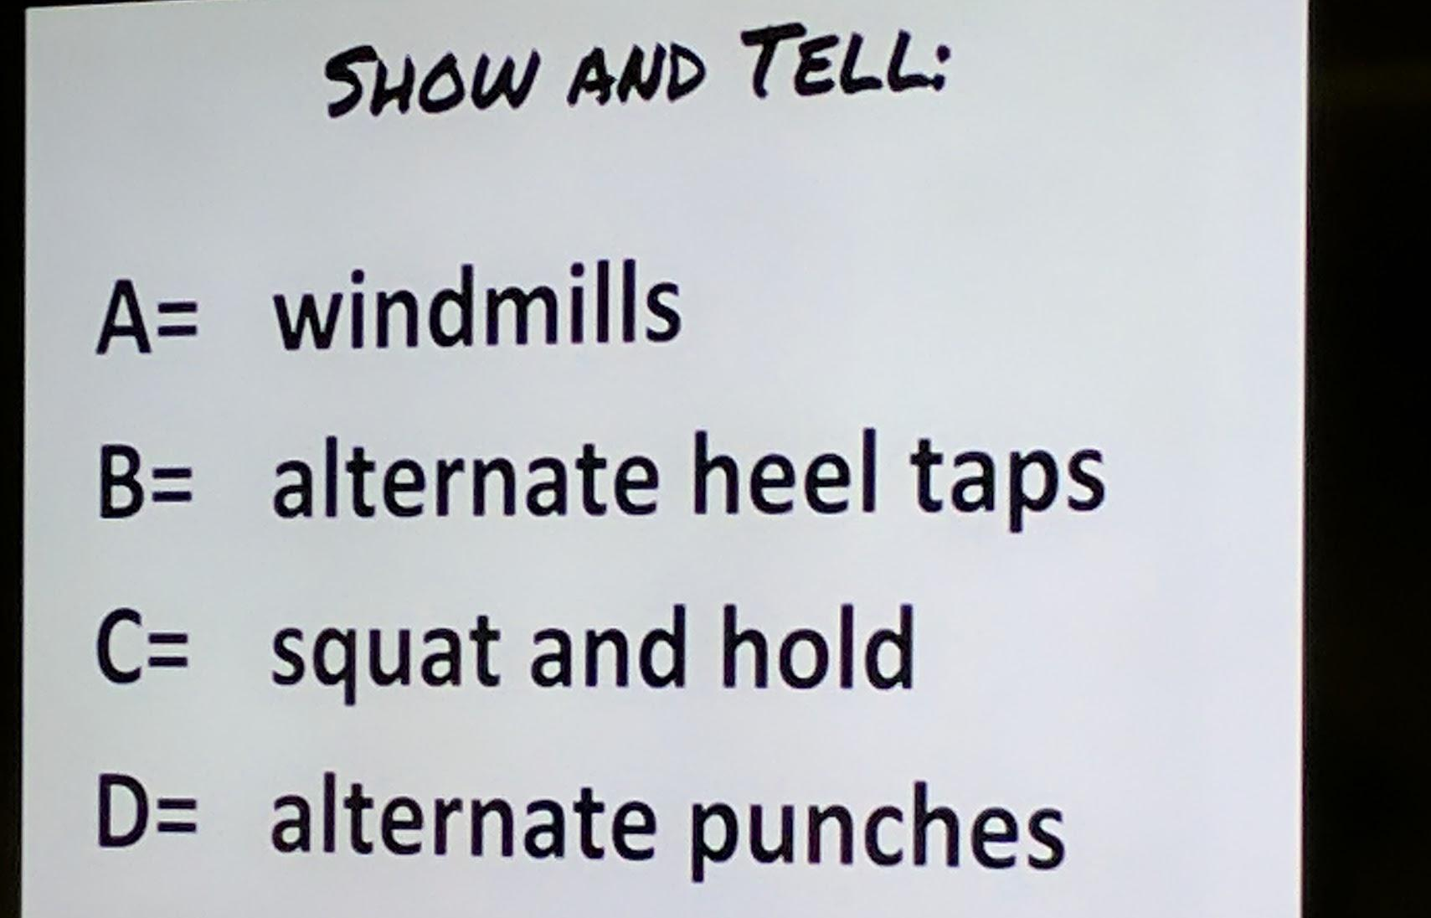
Examples of Strategies

Slide 24
Enrichment Opportunities

Slide 25
Options
Battle of the Books
National Junior Honor Society
Student Council
Chess Club
Sports Teams
Performing and Visual Arts (classes, groups, teams, clubs)
Student exchange trips (future?)
Global Studies
Middle School Musical

Slide 26


District Enrichment Opportunities

Slide 27
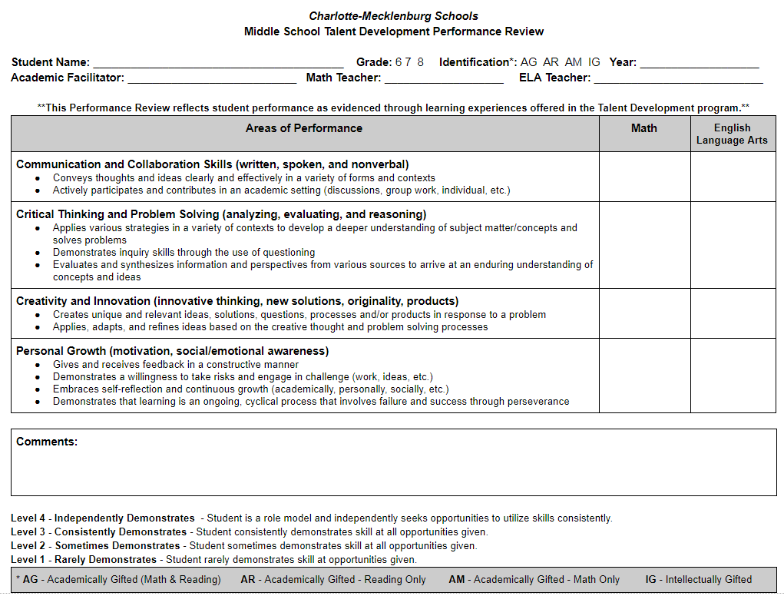
Performance Review
Performance Review is a documentation provide at the end of the school year for parents of gifted children.
Elements include the following domains of learning: Communication and Collaboration Skills, Critical Thinking and Problem Solving; Creativity and Innovation; Personal Growth

Slide 28
Performance Review
Opportunities to perform these indicators given throughout the year in ELA and Math classes
Teachers note differentiation strategies used and how students respond
Qualitative feedback on how your child’s gifted behavior shows up when differentiated instructional models, methods, and strategies are provided throughout the school year.
Problem solving - large component of math
Communication skills - large component of ELA

Slide 29
Questions?

Slide 30
Contact Information
Heather Lynch
heather.lynch@cms.k12.nc.us
(980) 343-5815

